Slide 1


Airbnb Pricing Strategy
Abhishek Shah
Guruprasad Panda
Abhijit Verma

Slide 2
Outline
Problem Statement
Initial Insights
Data Modeling
Lessons Learned
Next Steps

Slide 3
Problem statement
The aim of our project is trying to solve three problems with the Boston Airbnb dataset from two aspects, the hosts and the travellers. The problems are listed out below:
Help the host to decide the price based on the features of their listings provided
Help the travellers to choose the listings based on the location and also the overall review scores
Help the travellers to choose the listings based on the non-null text features in listings dataset

Slide 4
Why?
Importance:
For Hosts: Helps in maximizing revenue & maintaining competitive pricing.
For Airbnb: Enhances the platform's usability and attractiveness by ensuring fair and dynamic pricing.
Beneficiaries: Primarily Airbnb hosts in Boston, and indirectly, the platform and its users.

Slide 5
The Input
The input for our project encompasses a rich and diverse dataset from Boston's Airbnb listings, sourced from Kaggle.
Calendar Dataset: Tracks listing availability and pricing information, with details on dates and whether listings are available or booked.
Listings Dataset: Comprehensive dataset encompassing various attributes of Airbnb listings, including IDs, URLs, names, descriptions, host information, location details, amenities, prices, and review metrics.
Reviews Dataset: Contains reviews for listings, including the listing ID, review ID, date, reviewer ID and name, along with the text of the comments.

Slide 6
The Output
The project's outputs are tailored to address the specific needs of both Airbnb hosts and travelers in Boston, utilizing the rich dataset to generate actionable insights and recommendations.
These outputs are multifaceted and designed to enhance decision-making for both user groups:
Optimized Pricing Recommendations for Hosts
Curated Listing Recommendations for Travelers
Evaluation Metrics and Insights
Visual and Interactive Outputs

Slide 7
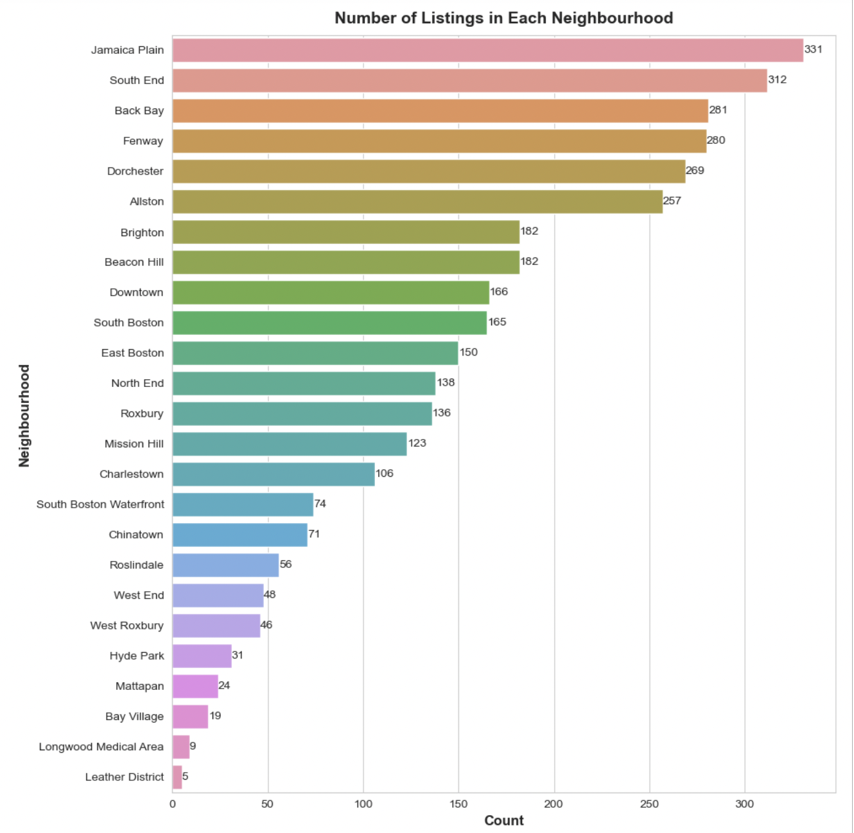
Exploratory Data Analysis

Slide 8
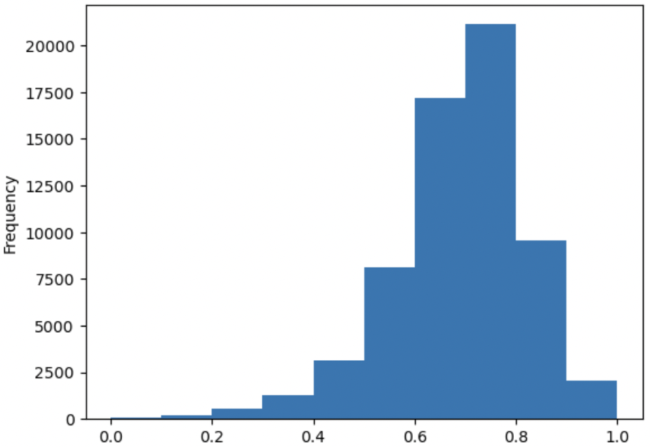
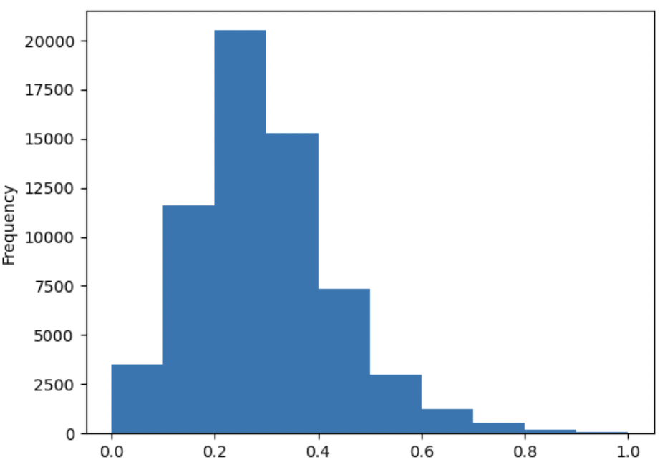
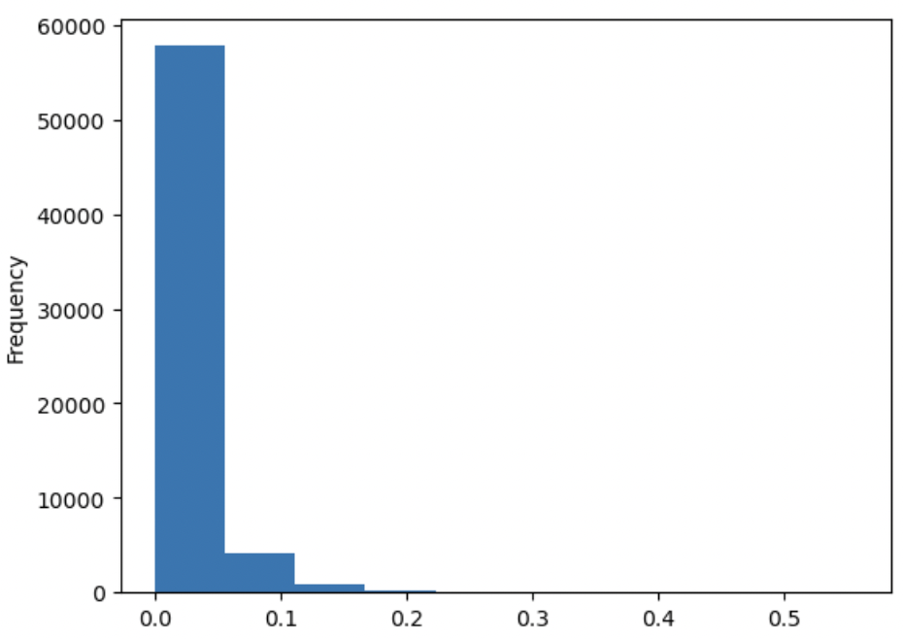
Sentiment Analysis of Review Comments
01
Neutral Score
Neutrality Trends: Most comments are neutral, with high neutrality scores prevalent.
Positivity Insight: Positive sentiments are typically subdued, with scores clustering close to 0.
Negativity Rarity: Negative sentiments are scarce, as indicated by scores concentrated near 0.
Positive Score
Negative Score

Slide 9
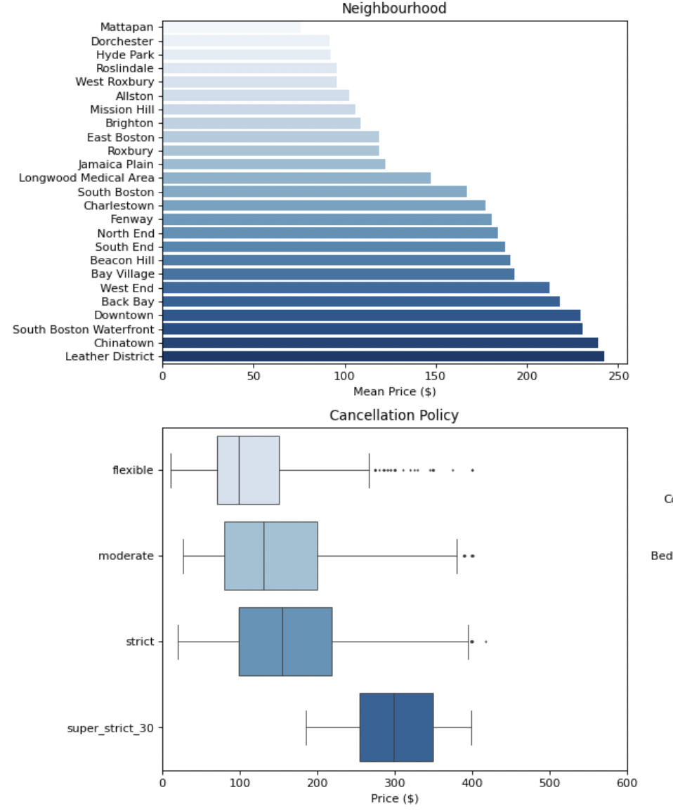
Insights from Neighbourhood and Cancellation Policy Analysis
02
1
Leather District has the highest mean price; Mattapan the lowest.
'Super Strict 30' has highest median price.
'Strict' and 'Moderate' show similar price distributions.
'Flexible' policy listings generally have lower median prices.

Slide 10
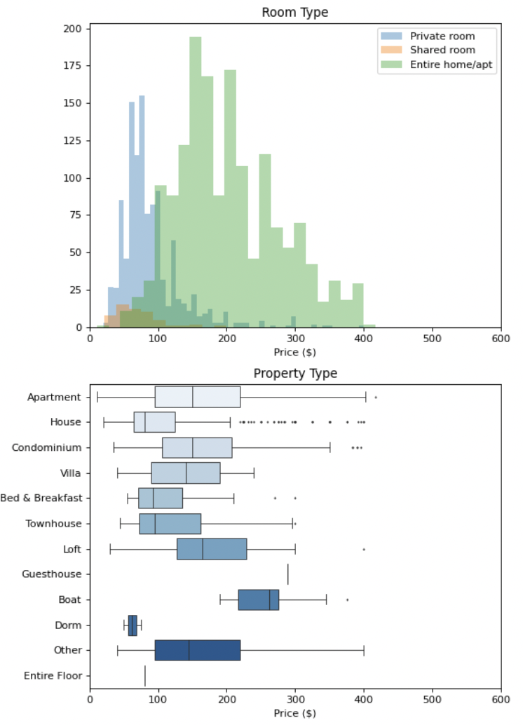
Insights from Room Type and Property Type Analysis
03
Entire homes/apartments typically have higher price points.
Private and shared rooms are priced lower, with a narrower price distribution.
'Boat' category tends to have a higher median price.
'Apartments' and 'Houses' are common with a wide range of prices, including several outliers.

Slide 11
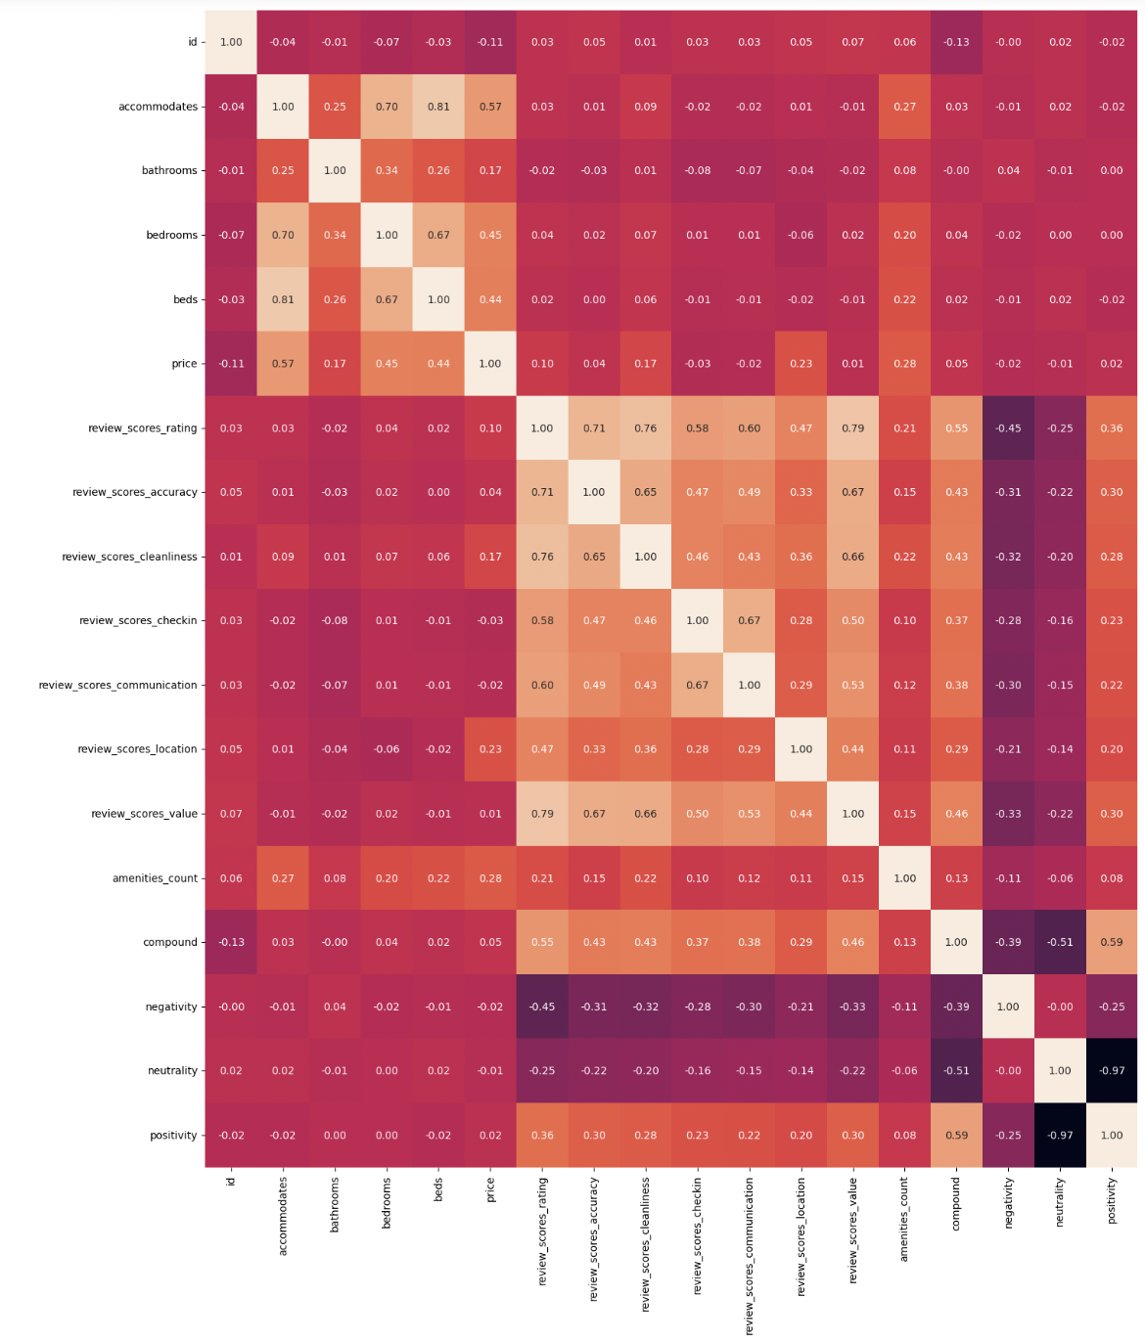
Correlation among the Airbnb Listing Features
04
Review Scores correlates strongly with review ratings, accuracy, cleanliness, check-in, communication, and location.
Price correlates strongly with accommodations, bedrooms, and amenities.

Slide 12
Data Modeling - Price Prediction

Slide 13
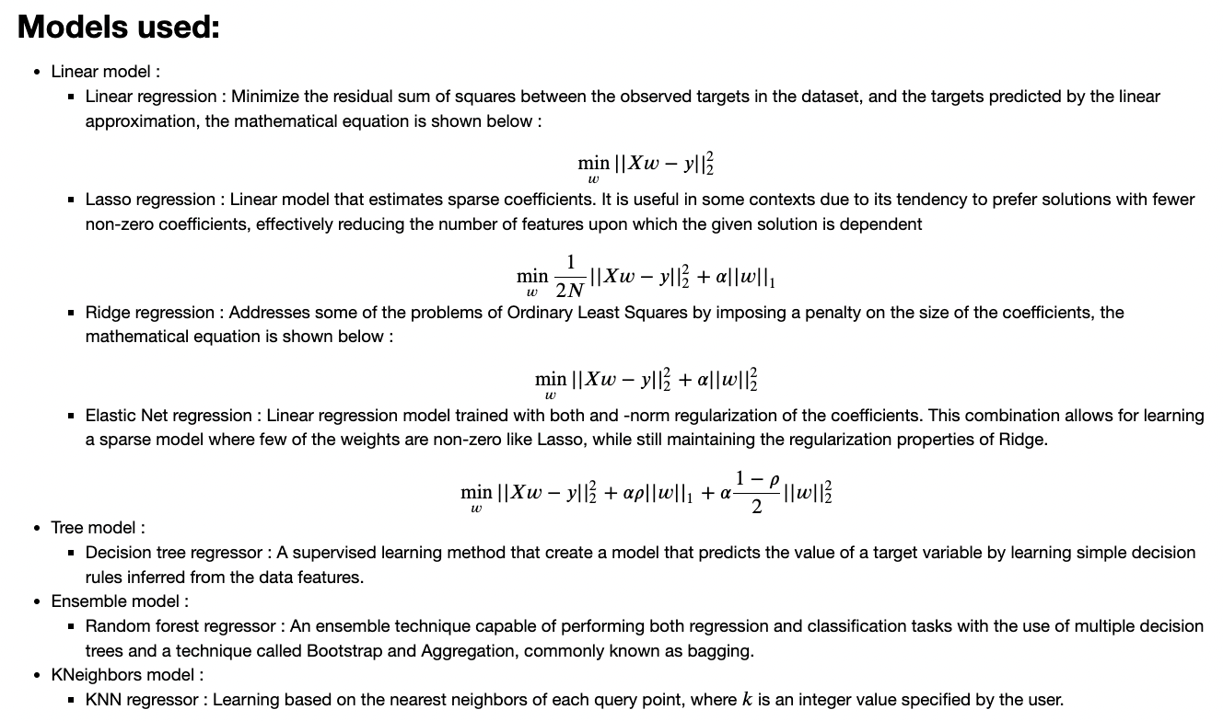

Slide 14
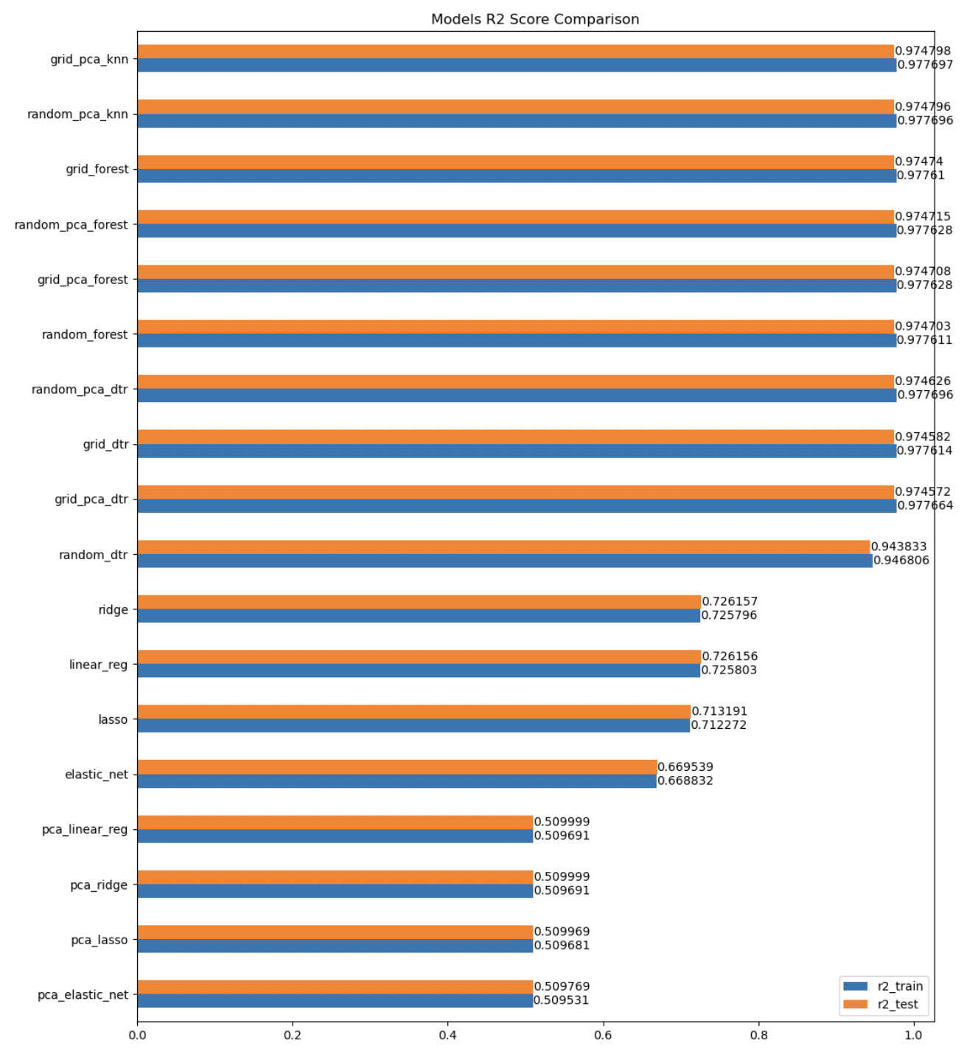
Model Evaluation Metric 1
R² Score for Model Explanation Power:
R² provides an understandable measure of how much of the variability in the price can be explained by the model's independent variables.
Models with 'grid_pca_' and 'random_pca_' prefixes show strong fit.
The 'grid_pca_knn' and 'random_pca_knn' model stands out with the highest R² in both training and testing.

Slide 15
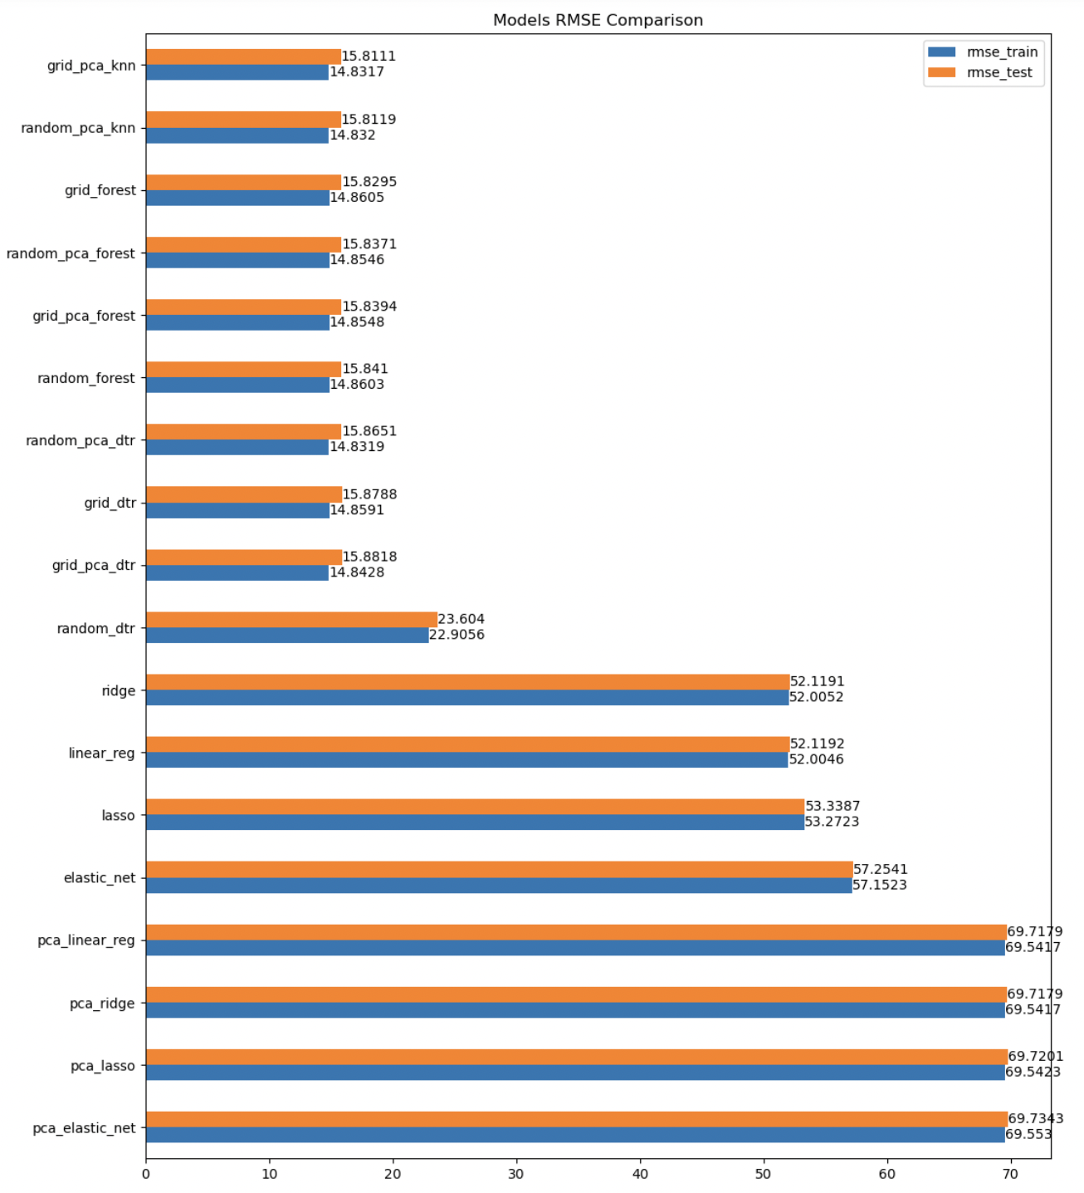
Model Evaluation Metric 2
RMSE for Predictive Accuracy:
RMSE measures the average magnitude of the prediction errors, giving a clear indication of how far off the predictions are from the actual values.
Models with 'grid_pca_' and 'random_pca_' prefixes show strong fit.
The 'grid_pca_knn' and 'random_pca_knn' model stands out with the highest RMSE in both training and testing.

Slide 16
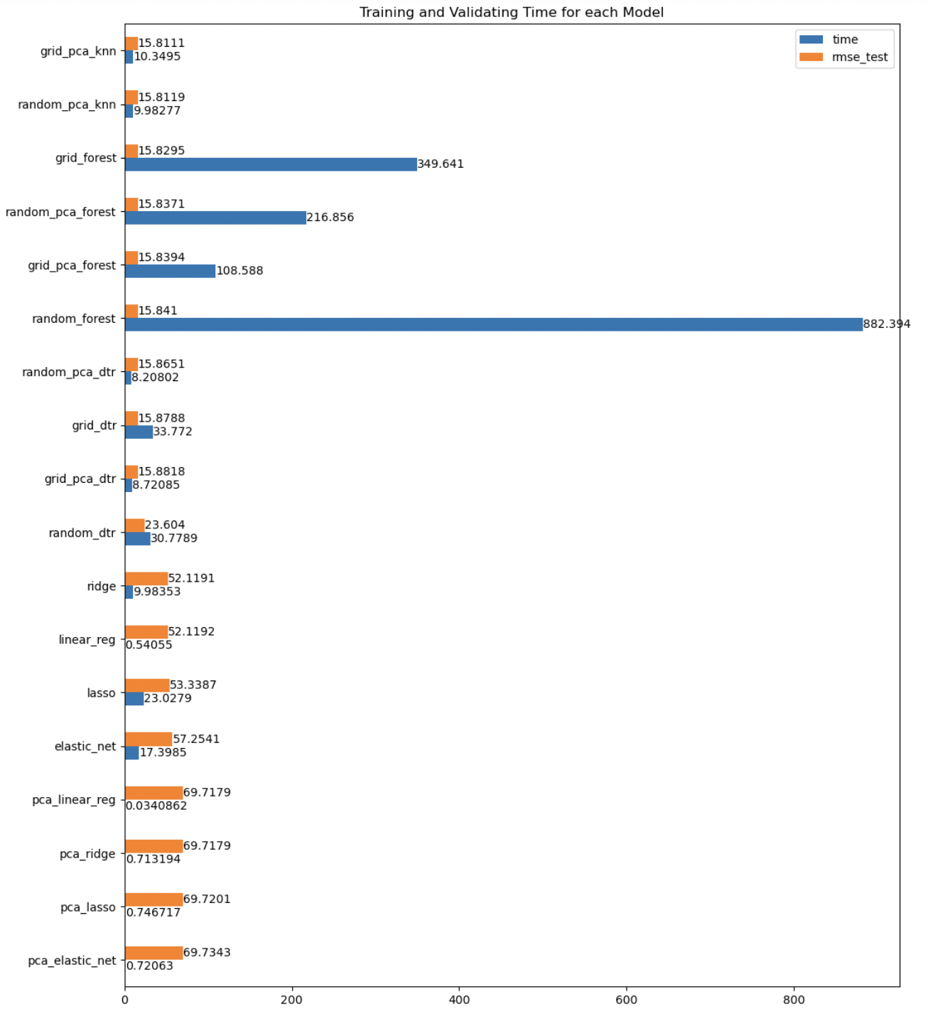
Model Evaluation Metric 3
Model Training, Validation Time & Performance:
Efficiency vs. Performance: 'grid_forest' model shows extensive training time without a proportionate decrease in RMSE, questioning time efficiency.
Performance Trade-offs: 'random_forest' model's high RMSE and long training time might reflect complexity and potential overfitting.
PCA Model Insights: PCA-based models ('pca_linear_reg', 'pca_ridge', 'pca_lasso', 'pca_elastic_net') train rapidly due to reduced dimensions but at the cost of higher RMSE, indicating potential loss of critical data.

Slide 17
Model Performance Summary
Top Model: Decision Tree Regressor outperforms others, ideal for this dataset.
Linear Model Performance: Linear, Ridge, and Lasso regressions are moderate; Elastic Net performs the worst.
Dimensionality Reduction: With only 4 features, KNN and Decision Tree Regressors excel, while linear models drop in performance.
Time Efficiency: Decision Tree offers a balance of good performance and faster computation compared to the more time-intensive Random Forest Regressor.
Best Model: Random Forest, KNN, or Decision Tree could guide hosts in pricing with an RMSE of $16, indicating high accuracy.

Slide 18
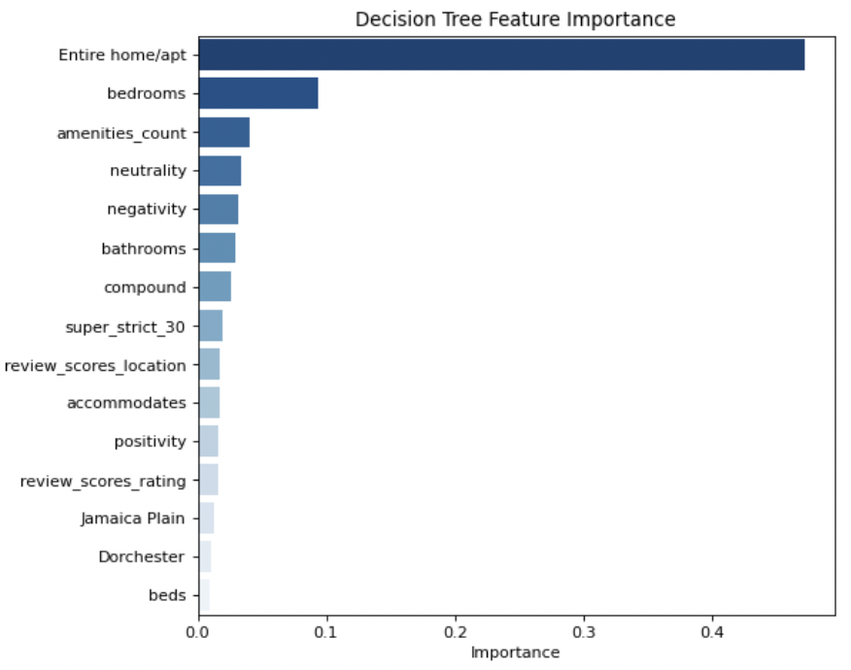
Decision Tree Model - Feature Importance Analysis
Most Predictive Feature: 'Entire home/apt' is the strongest predictor, indicating the type of listing as key.
Note: Feature importance values are all below 0.5, indicating a diverse set of factors contributing to the model's predictions.

Slide 19
Clustering by Text Features Overview

Slide 20
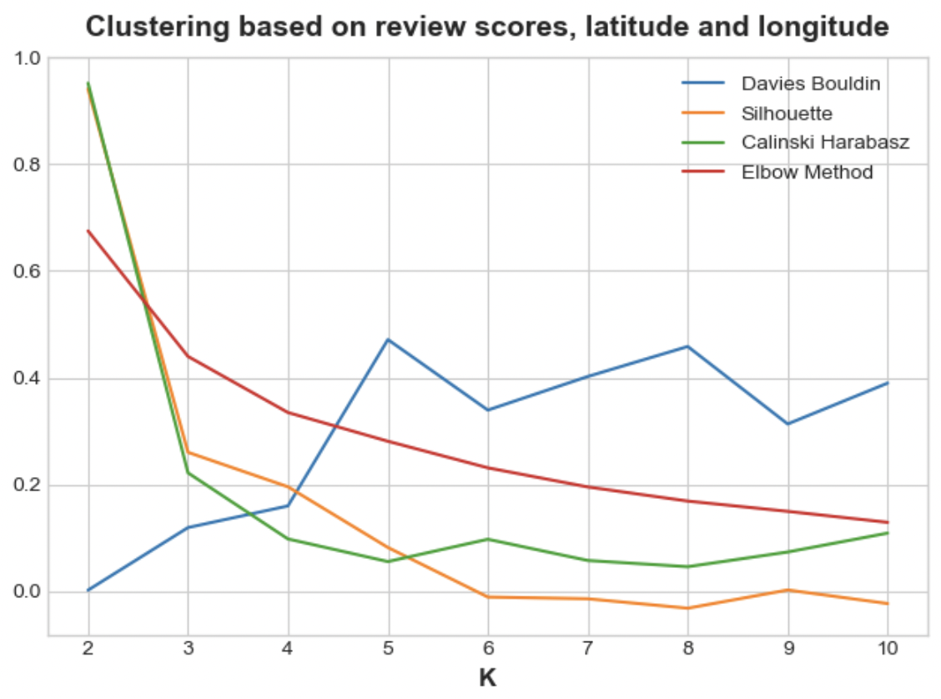
Listings clustered based on geographic coordinates and review scores
WHY?
The clustering approach can unveil strategic insights for Airbnb hosts to optimize pricing and enhance guest satisfaction.
Algorithm Used: K-Means Clustering
Optimal Clusters: 3

Slide 21
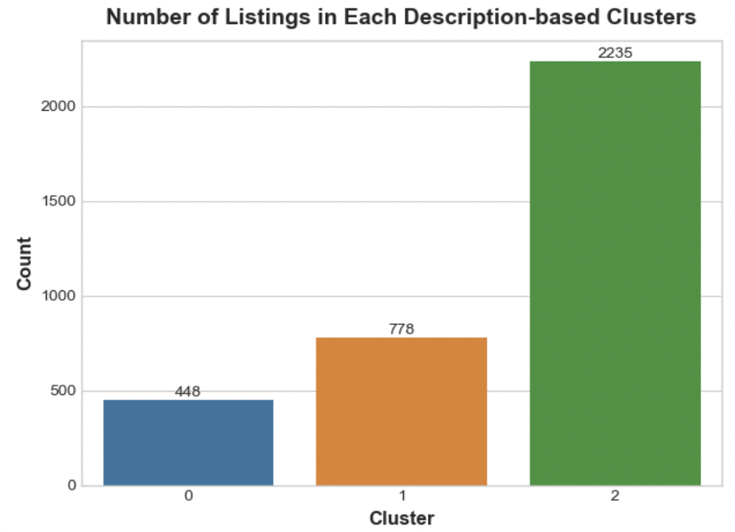
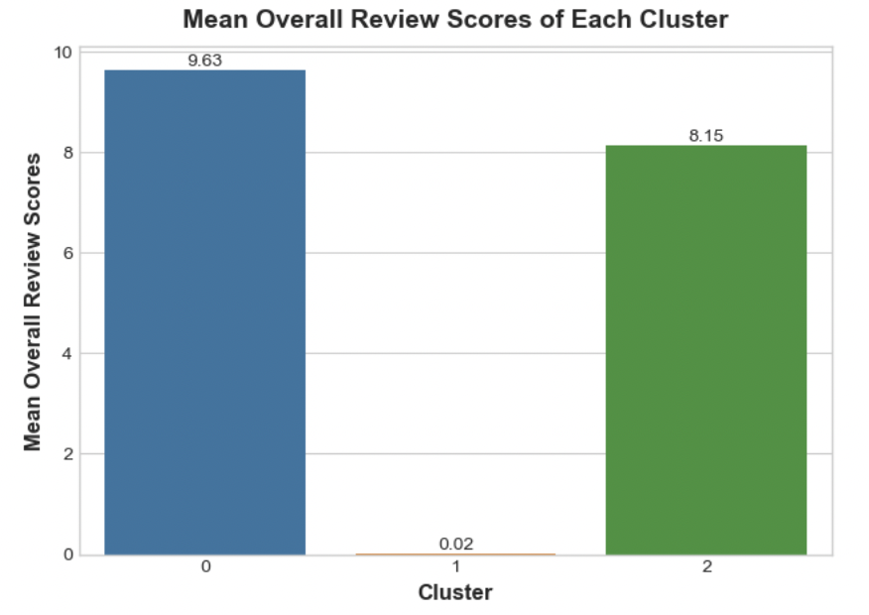
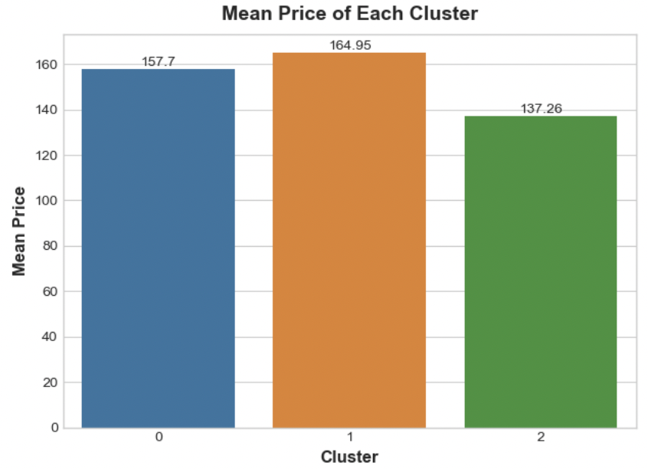
Cluster 0: Premium & Satisfying:
448 listings, avg. price $157.70
High satisfaction (9.63)
Well-received, moderate pricing
Cluster 1: Unusual & Incomplete
778 listings, avg. price $164.95
Low review score (close to 0)
Data concerns, needs investigation
Cluster 2: Affordable & Popular
2,235 listings, avg. price $137.26
Good satisfaction (8.15)
Diverse, lower pricing, generally well-received

Slide 22
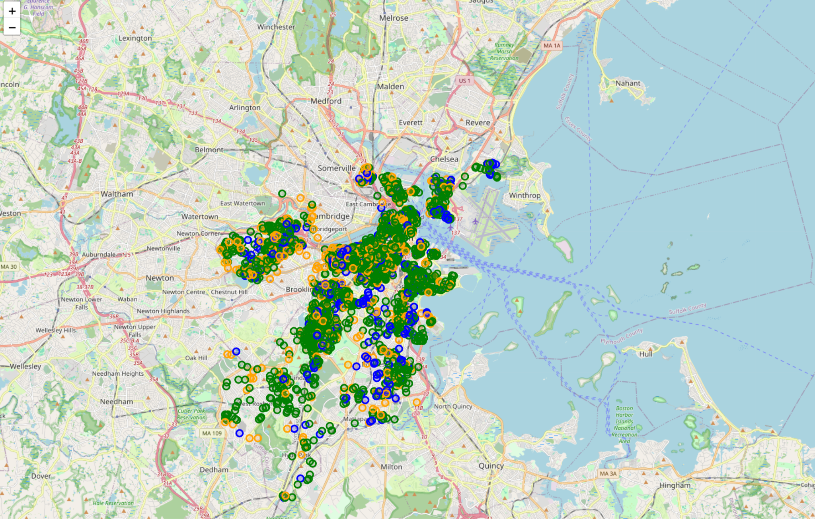
Key Takeaways:
No dominant cluster in a specific region.
Mixed distribution of listing types.
Cluster 1 has anomalous low satisfaction.
Investigate reasons for low satisfaction relative to price.
The clusters can inform property owners and platform hosts about pricing strategies and potential areas for service improvement based on guest feedback.

Slide 23
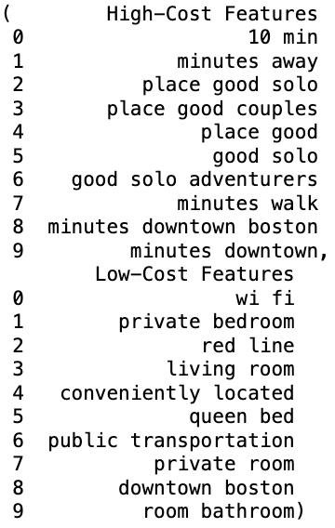
Top Text Features by Price:
High-Cost Features:
Proximity ("10 min", "minutes away").
Appeal to solo/couples ("place good solo", "place good couples").
Quality and comfort ("good solo adventurers").
Downtown convenience.
Low-Cost Features:
Practical amenities ("wi fi").
Private/shared spaces ("private bedroom", "private room").
Public transportation ("red line", "public transportation").
Essential features ("queen bed", "room bathroom").
Importance: Hosts can use these features and language cues to tailor property descriptions for different price points to attract specific audiences.
Notes:
Bigram (2-gram): A bigram is a sequence of two consecutive words or tokens in a text. It's a way to represent the relationship between two adjacent words. For example:
"Natural Language" in the sentence: "Natural language processing is fascinating."
"Machine Learning" in the sentence: "Machine learning algorithms are powerful."
Trigram (3-gram): A trigram is a sequence of three consecutive words or tokens in a text. It captures the relationship between three adjacent words. For example:

Slide 24
Gauging the Achievement
Determining the success of our project involves assessing how effectively we've met our objectives in assisting Airbnb hosts with pricing and aiding travelers in selecting listings.
Success in this context isn't just about the technical accuracy of our models but also about the practical impact and user satisfaction.
Key measures:
Success for Hosts - Accuracy and Satisfaction in Pricing
Success for Travelers - Relevance and Utility of Recommendations
Continuous Improvement

Slide 25
Lessons Learned
Comprehensive Data Analysis: Essential for uncovering patterns, anomalies, and understanding price, sentiment, and geographic trends in datasets.
Text Data Complexity & Preprocessing: Presents unique natural language processing challenges, underscoring the need for robust preprocessing in sentiment analysis.
Model Complexity vs Performance: Balancing simplicity with detailed accuracy, tailored to specific problem complexities.
Outliers' Impact and Handling: Significantly affects model accuracy, especially in price predictions, necessitating strategic outlier detection and management.

Slide 26
Next Steps
Advanced Text Analytics: Implement deep learning for richer text analysis and sentiment insights.
Dynamic Pricing Model: Create a model adjusting to market, seasonal trends, and user feedback.
User Feedback Integration: Use feedback for refining prediction and recommendation accuracy.
Dataset Expansion: Include data on local events, weather, economic factors, and other cities.
Model Interpretability and Ethics: Enhance model clarity and address data privacy and bias.

Slide 27
Questions?

Slide 28
References
Airbnb Open Data on Kaggle
Scikit-Learn Documentation

